Slide 1
Assignment 1B Presentation EECE 443 Team 2: MCU TNC Design Kaleb Leon – C00094357 Kobe Keopraseuth – C00092349 David Cain – C00043561 March 10th, 2020

Slide 2
MCU TNC Assignment 1B
David Cain, Kobe Keopraseuth, and Kaleb Leon

Slide 3
Agreements
References needed to be corrected to include the Direwolf project as a previous research of work done by others
Needed an HDLC diagram in the research of work done by others sections
References needed to include the mentors with their credentials
Needed a AFSK diagram to visualize the modulation technique
Needed programming language alternatives and tradeoffs
Needed basic algorithm alternatives and tradeoffs
A corrected objective tree was created to be more legible for presentations/inclusion in the paper
Grammatical Errors

Slide 4
Disagreements
With reference to the Level 0 Functional Block Diagram, it was suggested to address abstract requirements
- This topic will be elaborated on further in the functional requirements section of the paper
Objective tree was stated to not add up to 100% at the third level
- Power consumption does not extend to the third level, which is why it appears to not add up to 100%
Gantt chart was suggested to included “Human Resources”
- When constructing the Gantt Chart, the program was set to not include weekends as personal days
The AFSK section was noted to have incorrect formatting
- Not sure what this is referring to, section seems to follow IEEE notation
You need to explain the tree more thoroughly as to your rational for setting up the tree this way
- Above the objective tree, this section documents our reasoning thoroughly

Slide 5
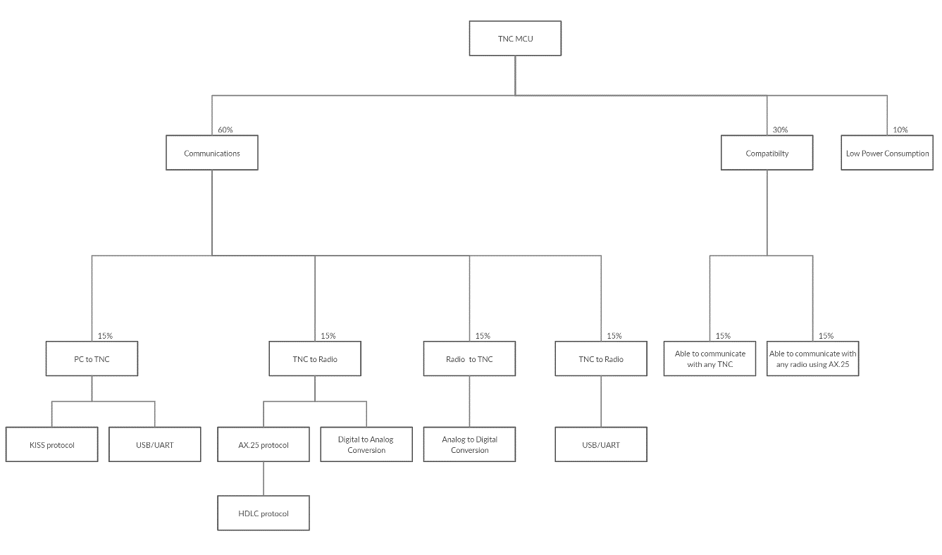
Original Objective Tree

Slide 6
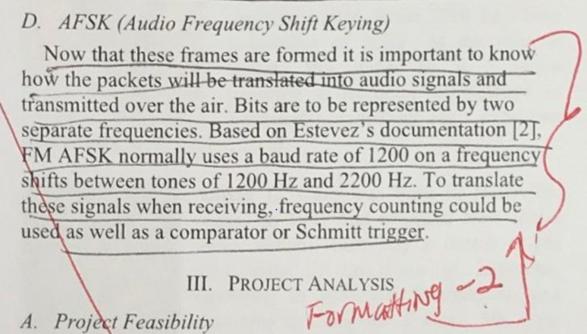
Formatting Issue

